Slide 1
Front End Engineering-I Project
Team Details:
Ananya Aggarwal (2310990109)
Aniket (2310990110)
Anirudh Jindal (2310990111)
Faculty Coordinator:
Dr. Amandeep Kaur
Chitkara University Institute of Engineering and Technology,
Chitkara University, Punjab

Slide 2
Table of Contents
Introduction
Problem Statement
Technical Details
Key Features
Project Highlights
Bonus Feature
Conclusion
References/Links used

Slide 3
Introduction
Note Log
Team Members:
Ananya Aggarwal (2310990109)
Aniket (2310990110)
Anirudh Jindal (2310990111)
Description:
The project aims to design and build a notes app that can take multiple entries per note. It should allow users to select a note when they launch the app. When they choose a note, a new entry will be automatically tagged along with the current date, time, and location. Users can also sort and filter their entries based on this metadata. This is a great web app for tracking events and resolving messy calendar problems.

Slide 4
Problem Statement
The project "Note Log" aims to address the problem of disorganized note-taking and information management. In today's digital age, individuals and professionals often find themselves overwhelmed with information from various sources, such as meetings, lectures, articles, and personal insights. The lack of an efficient and centralized system to capture, organize, and retrieve this information can lead to inefficiency, forgetfulness, and difficulty in accessing critical data when needed.
Background Information and Research:
Information Overload: With the proliferation of digital content and the increasing demands of work and study, people are constantly bombarded with information. This leads to difficulties in sorting through and extracting valuable insights from the vast amount of data available.
Ineffective Note-Taking: Traditional note-taking methods, such as physical notebooks or scattered digital files, often lack structure and organization. This can make it challenging to find and reference specific notes or ideas later.

Slide 5
Problem Statement
Loss of Valuable Insights: When notes are disorganized or scattered across various platforms, valuable insights and ideas can easily get lost, leading to missed opportunities for personal and professional growth.
Inefficient Time Management: Manually managing notes and information can be time-consuming and counterproductive, diverting time and effort away from more meaningful tasks and projects.
Need for Cross-Platform Accessibility: People often use multiple devices and platforms for note-taking and information capture. Having a system that seamlessly synchronizes and provides access across different devices and operating systems is crucial for productivity.

Slide 6
Technical Details
HTML: HTML is used to structure and organize the content of the web application. It defines the layout and hierarchy of elements such as headers, paragraphs, lists, and more, making the content readable and logically structured.
CSS: CSS is used to define the layout of the application, and positioning elements such as headers, navigation bars, sidebars, and content areas. It ensures that the interface is visually appealing and well-structured. CSS sets the fonts, sizes, line spacing, and colors for text content within notes, headings, menus, and buttons, enhancing readability and aesthetics.
JavaScript: JavaScript is essential for adding interactivity to the application, enabling features like real-time updates, dynamic content, and user interactions.

Slide 7
Key Features
Following are the key features needed to solve the problem of disorganized note-taking and information management in a "Note Log" application include:
User Registration and Authentication: Allow users to create accounts and log in securely to access and manage their notes.
Note Creation and Editing: Provide a user-friendly editor for creating, editing, and formatting notes with text, images, and links.
Note Organization: Support categorization and tagging of notes to help users organize and find their content easily.
Search Functionality: Implement a robust search feature with filtering options to quickly locate specific notes.

Slide 8
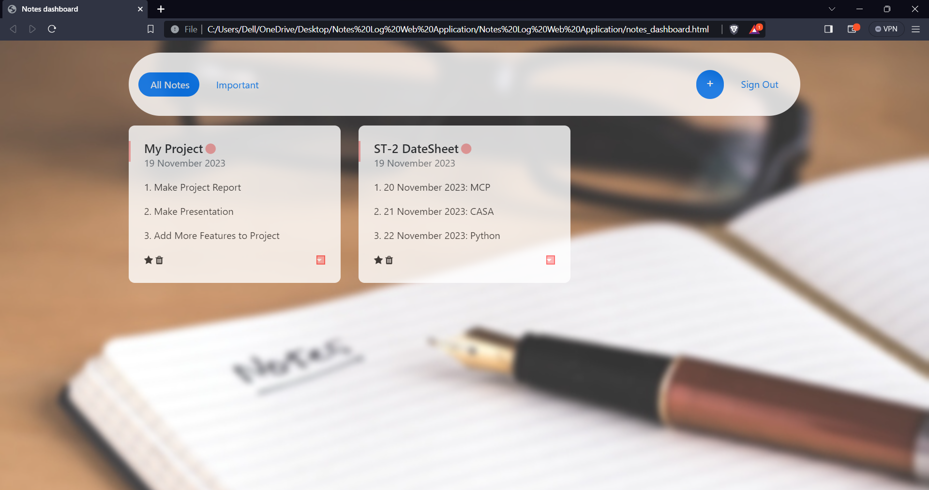
Project Highlights

Slide 9
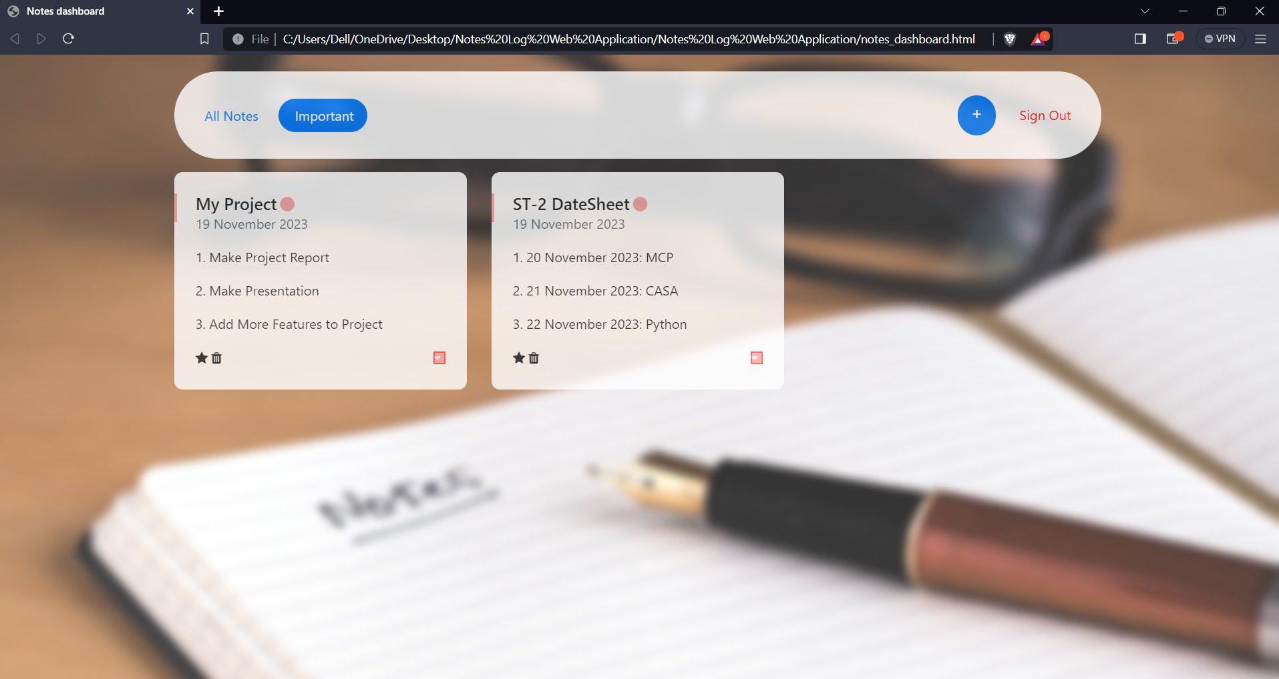
Project Highlights

Slide 10
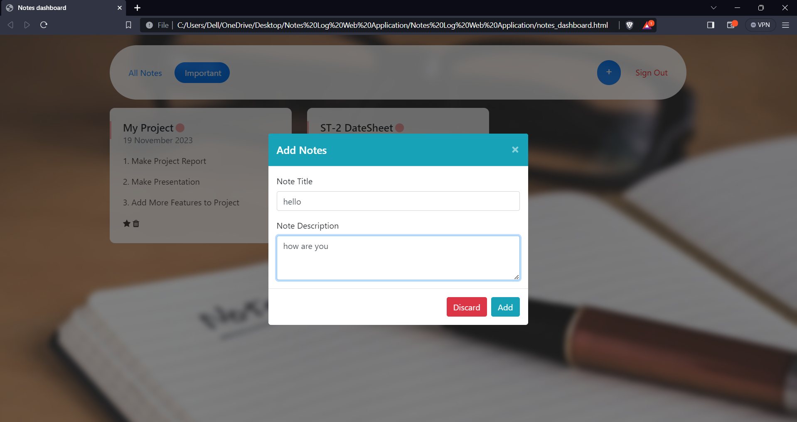
Project Highlights

Slide 11
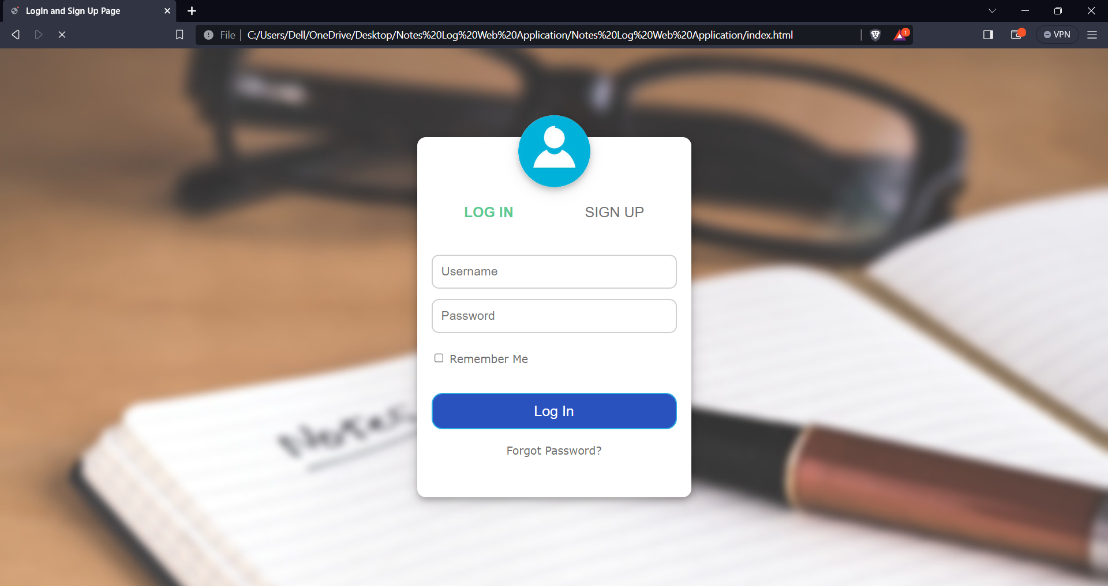
Project Highlights

Slide 12
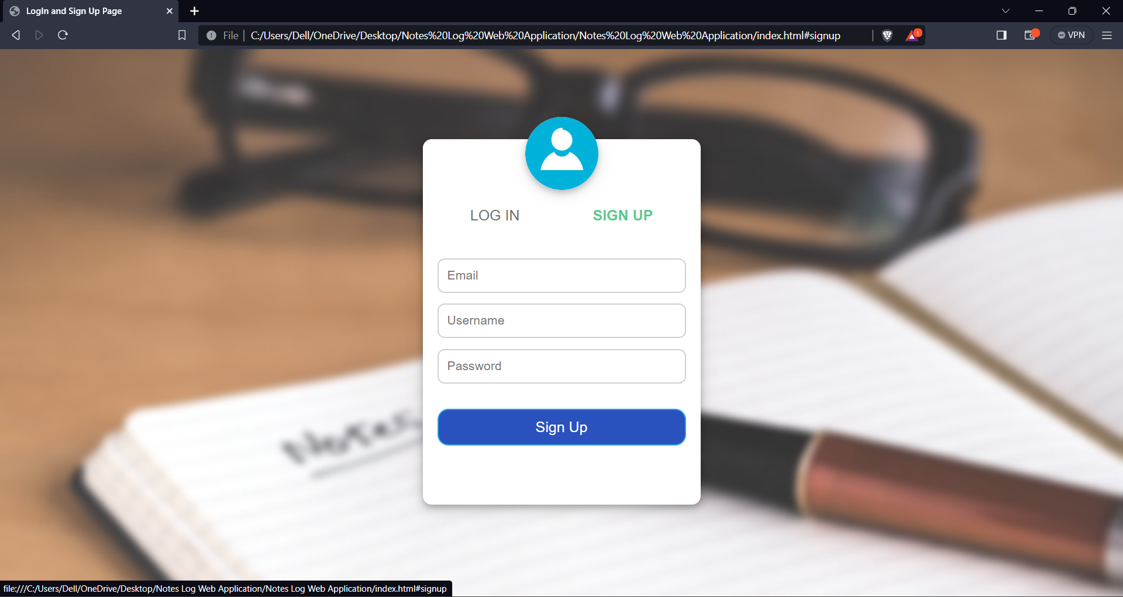
Project Highlights

Slide 13
Bonus Features
To make a "Note Log" web application even more appealing and useful to users, we are considering adding the following bonus features:
Attachment: Enable users to attach files (e.g., documents, images, PDFs) to their notes, ensuring that all relevant information is stored in one place.
Task Management: Include task management features within notes, with the ability to set due dates, priorities, and recurring tasks.

Slide 14
Conclusion
"Note Log" has the potential to revolutionize how individuals and professionals manage information and notes efficiently.
We learned the importance of adaptability, team work, user-centric design, and collaboration in creating a successful web application.
Our journey doesn't end here; we remain committed to enhancing "Note Log" based on user feedback and evolving needs.

Slide 15
References/Links used
W3Schools
YouTube

Slide 16


